Slide 1
Digital Forensics Hard Disks and File Systems
Dr. Tran The Son
Vietnam – Korea University

Slide 2
Content
Hardware
Software/Tools

Slide 3
Lab requirements
Computers that can connect to the internet and the intranet.
The administrative computer is used to keep track of logs and other things.
Hardware Write Blocker: is to keep the data on the evidence drive from being changed during the acquisition process.
CD/DVD drive.
USB reader.
HDD and SSD cases with a USB 3.0 port.
SD card reader.
USB 2.0 and USB 3.0 thumb drives of different sizes.
Tape drives are used to store long-term data.
Ethernet
cables (RJ-45), BNC adapters (such as modular adapters), etc.
License
EnCase
Belkasoft Evidence Center X
FTK (free + license)
X-ways
Open source
Sleuth Kit
Autopsy
DD for Windows
Magnet RAM capture (ko thảo luận)
Belkasoft RAM capturer (ko thảo luận)
Volatility
Memoryze
Mandiant Redline
Encrypted Disk Detector (EDD)
Digital Forensics Framework
Open Computer Forensics Architecture
Linux Windows
CSI Linux Sysinternals suite
CAINE
DEFT
Kali Linux

Slide 4
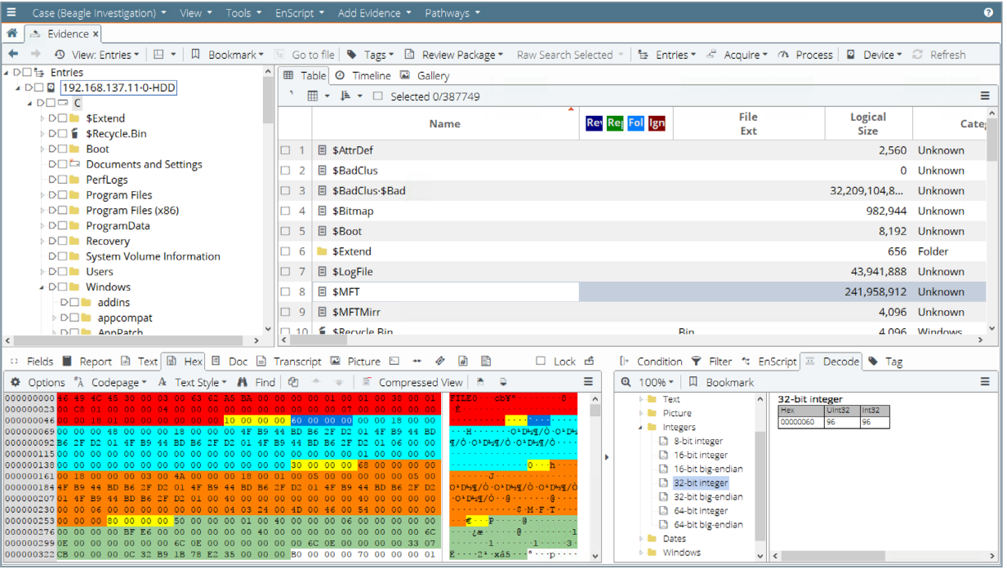
EnCase
https://security.opentext.com/encase-forensic
OpenText™ EnCase™ Forensic is a court-proven solution for finding, decrypting, collecting, and preserving forensic data from a wide variety of devices while ensuring evidence integrity and seamlessly integrating investigation workflows

Slide 5
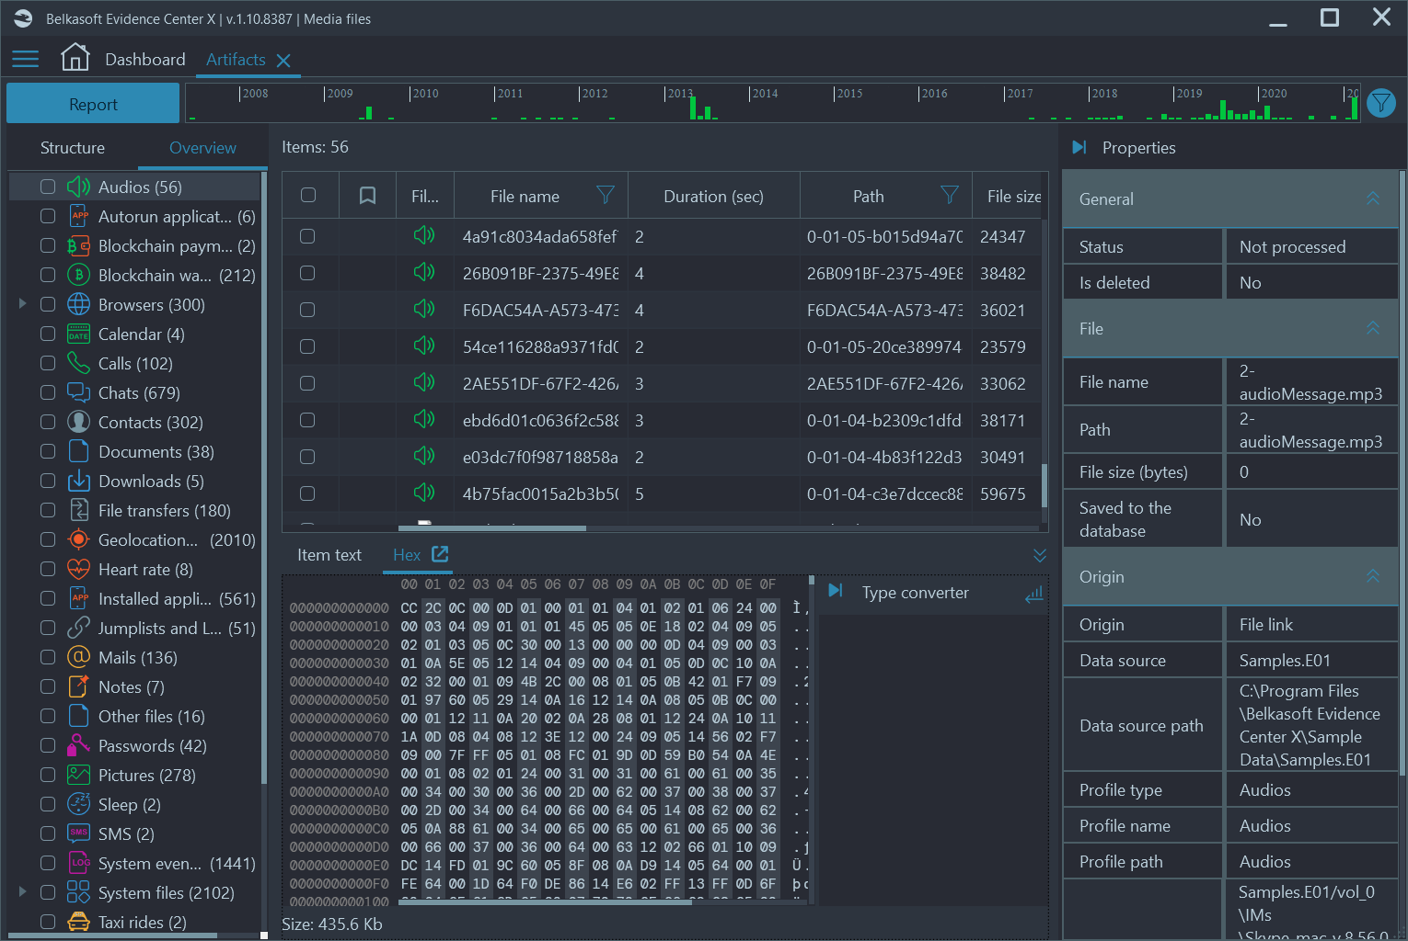
Balkasoft Evidence Center X
https://belkasoft.com/x
Acquire, examine, and analyze evidence from mobile, computer, drones, cars, and cloud storage

Slide 6
FTK® Imager
https://www.exterro.com/ftk-imager
FTK Imager is a free data preview and imaging tool used to acquire electronic evidence in a forensically sound manner by creating copies of computer data without making changes to the original evidence.
Create Forensic Images
Preview Data
Evaluate Evidence
Forensic imaging is the process of creating an exact duplicate (or “image”) of a digital storage device, such as a hard drive or memory card. This duplicate can then be analysed for evidence without affecting the original device.

Slide 7
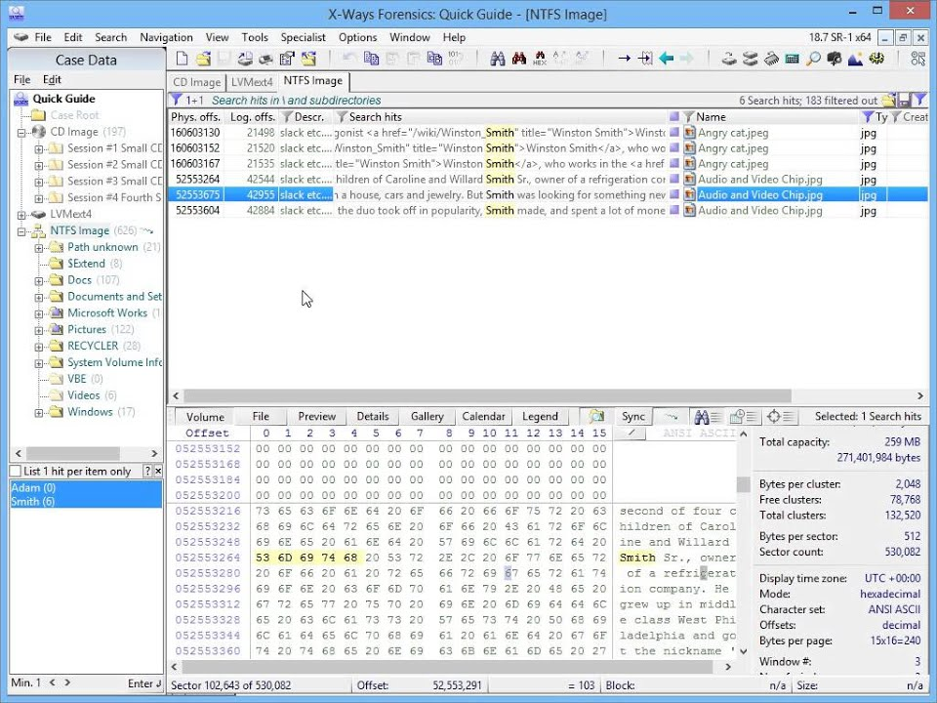
X-ways
http://www.x-ways.net/forensics/
X-Ways Forensics is an advanced work environment for computer forensic examiners and our flagship product. Runs under Windows XP/2003/Vista/2008/7/8/8.1/2012/10/2016/2019/11*, 32 Bit/64 Bit, standard/PE/FE
Disk cloning and imaging
Ability to read partitioning and file system structures inside raw (.dd) image files, ISO, VHD, VHDX, VDI, and VMDK images
Complete access to disks, RAIDs, and images more than 2 TB in size (more than 232 sectors) with sector sizes up to 8 KB
Built-in interpretation of JBOD, RAID 0, RAID 5, RAID 5EE, and RAID 6 systems, Linux software RAIDs, Windows dynamic disks, and LVM2
Automatic identification of lost/deleted partitions
Native support for FAT12, FAT16, FAT32, exFAT, TFAT, NTFS, Ext2, Ext3, Ext4, CDFS/ISO9660/Joliet, UDF
Superimposition of sectors, e.g. with corrected partition tables or file system data structures to parse file systems completely despite data corruption, without altering the original disk or image
Access to logical memory of running processes
…….

Slide 8
Open Computer Forensics Architecture
https://ocfa.sourceforge.net/
The Open Computer Forensics Architecture (OCFA) is a modular computer forensics framework built by the Dutch National Police Agency [KLPD/Dutch]. The main goal is to automate the digital forensic process to speed up the investigation and give tactical investigators direct access to the seized data through an easy to use search and browse interface.

Slide 9
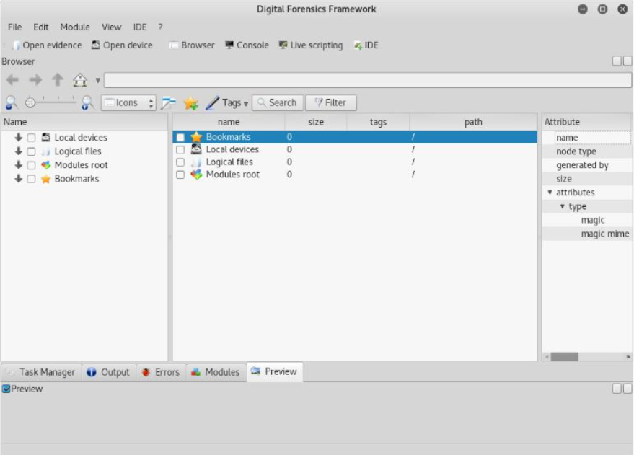
Digital Forensics Framework
https://spinningsecurity.com/digital-forensics-framework/
Digital Forensics Framework was a computer forensics open-source software. It is used by professionals and non-experts to collect, preserve and reveal digital evidence without compromising systems and data.
It preserves the digital chain of custody.
It can access local and remote devices.
It can read standard digital forensics file formats.
Virtual machine disk reconstruction.
It can be used for Windows and Linux Forensics.
It can quickly triage and search for meta-data.
It can recover hidden and deleted files and folders.
Used for volatile memory forensics.

Slide 10
Sleuth Kit
http://www.sleuthkit.org/sleuthkit/
Sleuth Kit® (TSK) is a library and collection of command-line tools that allow you to investigate disk images.
The core functionality of TSK allows you to analyze volume and file system data

Slide 11
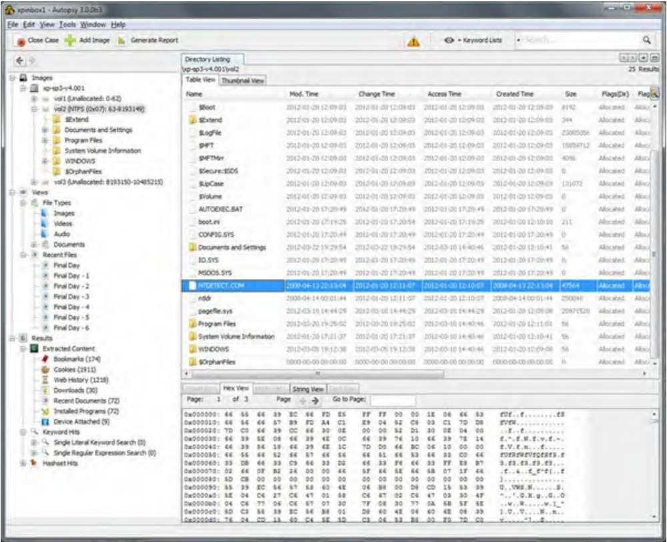
Autopsy
www.sleuthkit.org/autopsy
Autopsy® is a digital forensics platform and graphical interface to The Sleuth Kit® and other digital forensics tools.
Timeline analysis: Advanced graphical event viewing interface (video tutorial included).
Hash filtering: Flag knows bad files and ignores known good.
Keyword search: Indexed keyword search to find files that mention relevant terms.
Web artifacts: Extract history, bookmarks, and cookies from Firefox, Chrome, and IE.
Data carving: Recover deleted files from unallocated space using PhotoRec.
Multimedia: Extract EXIF from pictures and watch videos.
Indicators of compromise: Scan a computer using STIX

Slide 12
DD for Windows/Linux
http://www.chrysocome.net/dd
dd command is mainly used for copying and converting data, hence it stands for data duplicator.
Backing up and restoring an entire hard drive or a partition.
Creating virtual filesystem and backup images of CD or DVDs called ISO files
Copy regions of raw device files like backing up MBR (master boot record).
Converting data formats like ASCII to EBCDIC.
Converting lowercase to uppercase and vice versa.
Syntax
dd if=<source file name> of=<target file name> [Options]

Slide 13
DD for Windows/Linux
You should be very careful while using this command as improper usage may cause huge data loss. So, some people consider dd tool as disk destroyer. Without knowing or being careless can cause the destruction of partition and metadata from the block device.
Backup entire disk to disk
sudo dd if=/dev/sda of=/dev/sdb bs=4096 conv=noerror,sync
Creating dd disk image (file image)
sudo dd if=/dev/sda of=/tmp/sdadisk.img
Creating a compressed disk image
sudo dd if=/dev/vda | gzip -c >/tmp/vdadisk.img.gz
Backup/Clone a partition
sudo dd if=/dev/sda1 of=/dev/sdb1 bs=4096 conv=noerror,sync
Restoring a disk or a partition image
sudo dd if=/tmp/sdadisk.img of=/dev/sda
https://linuxopsys.com/topics/linux-dd-command-with-examples

Slide 14
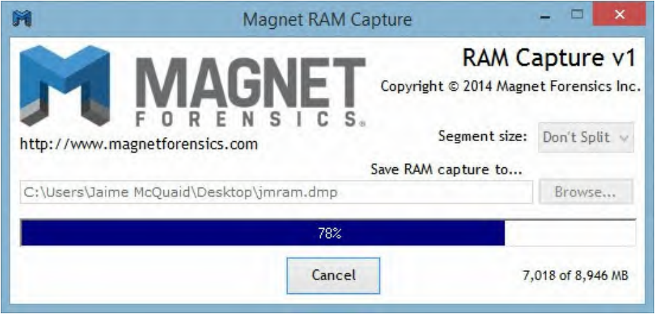
Magnet RAM capture
https://www.magnetforensics.com/resources/magnet-ram-capture/
This tool allows investigators to acquire the memory of a live PC

Slide 15
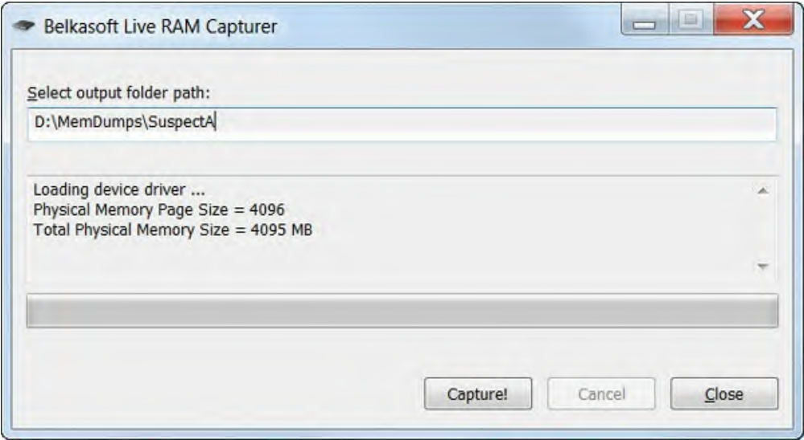
Belkasoft RAM capturer
https://belkasoft.com/ram-capturer
this application is capable of dumping your RAM to a specified output folder.

Slide 16
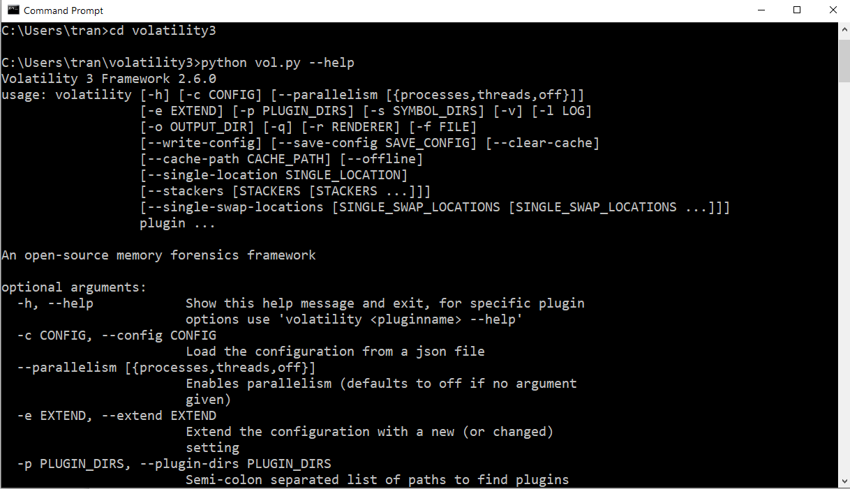
Volatility
https://www.volatilityfoundation.org/releases-vol3
Volatility introduced people to the power of analyzing the runtime state of a system using the data found in volatile storage (RAM).

Slide 17
Volatility
Dump netscan
Dump pslist
Dump LSA credentials
……. Check more
python3 vol.py -f <filename> windows.netscan
python3 vol.py -f <filename> windows.pslist
python3 vol.py -f <filename> windows.lsadump
python3 vol.py -- help

Slide 18
Exercise
Vào FTP server tải về Magnet (MRCv120.exe) hoặc Belksoft (RamCapturer.zip)
Chạy Magnet hoặc Belksoft
Đổ RAM ra 1 file
Cài đặt và Sử dụng Volatility để đọc thông tin về username và mật khẩu theo cú pháp
Cài đặt FTK vào máy tính
Tạo 1 image bằng FTK
Volume C, D, (tùy ý)
Restore deleted files
python3 vol.py -f <filename> windows.lsadump

Slide 19
Linux distributions
CSI Linux
CAINE
DEFT
Helix
SIFT
Santoku Linux
Kali Linux

Slide 20
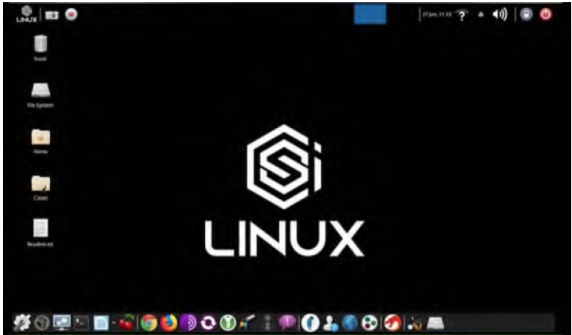
CSI Linux https://csilinux.com/download/

Slide 21
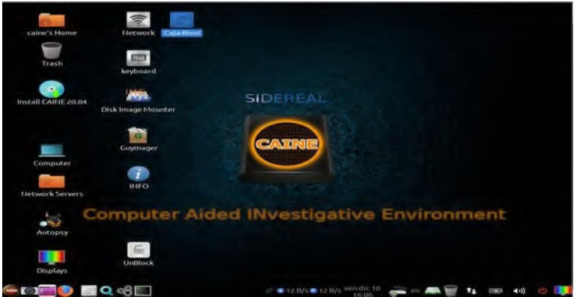
CAINE https://www.caine-live.net/

Slide 22
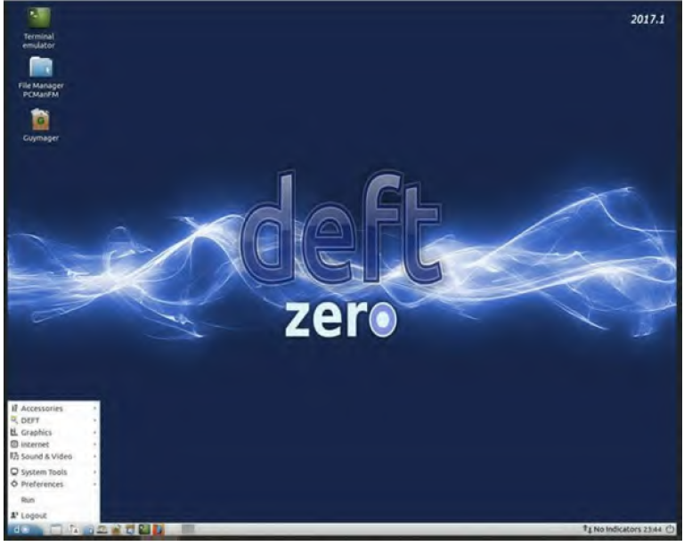
DEFT https://distrowatch.com/table.php?distribution=deft

Slide 23
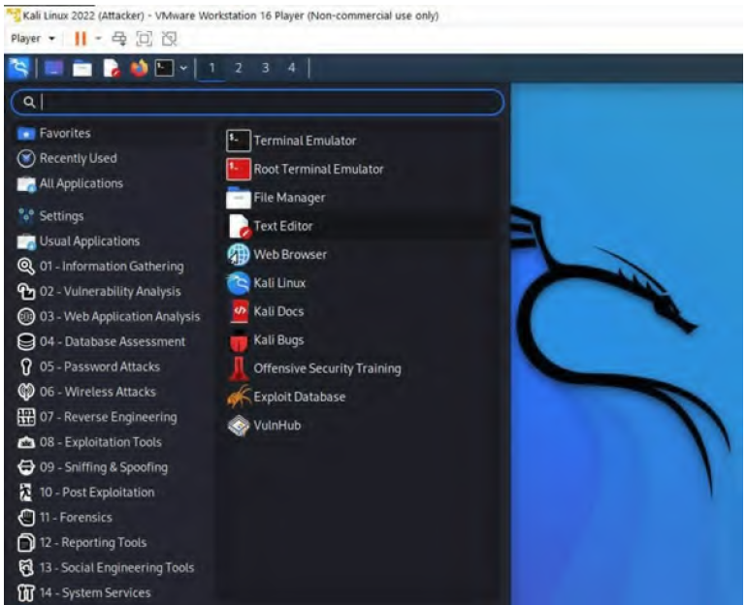
Kali Linux https://www.kali.org/get-kali/

